Slide 1

Project: Employee Promotion Presented by Project-P151 Team 3
Team members: Mentors:
samarthini Neha
Kajal Gagare Himavanth
Shubham kand
Pavan Bharambe
Mita Sakhare
Abhishek Shinde
Minal Awachar

Slide 2
Business Problem To predict if a person is eligible for promotion or not
Business Objective:
The goal here is to model the probability that a person is promoted or not from different features.

Slide 3
Project Architecture / Project Flow
EDA and visualization
Feature Engineering
Model building
Model Results
Model Evaluation
Deployment

Slide 4
Data set includes
employee id :Unique ID for the employee
department : Department of employee
Region : Region of employment (unordered)
education : Education Level
gender : Gender of Employee
recruitment channel : Channel of recruitment for employee
no_of_training : no of other training completed in the previous year on soft skills,technical skills,etc
age : Age of Employee
previous_year_rating : Employee rating for the previous year
length_of_service : Length of service in years
awards_won : if awards won during the previous year then 1 else 0
avg_training_score : Average score in current training evaluations
is_promoted : (Target) Recommended for promotion

Slide 5
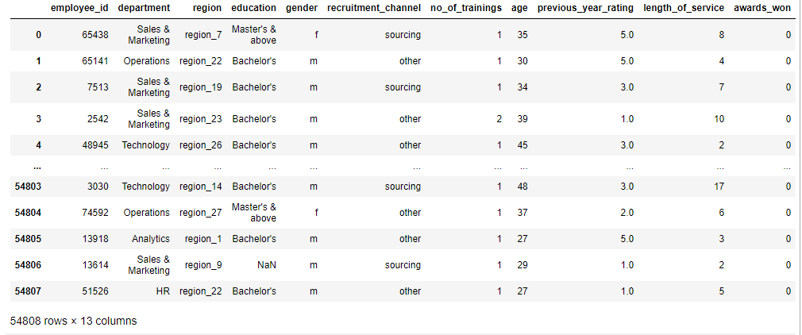
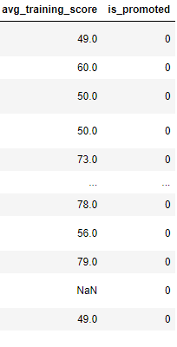
Data set details
d
Data file contains 13 colums about 54808 rows
Is_promoted is the target variable
There are 225 duplicated values

Slide 6
Exploratory Data Analysis (EDA)
There are missing values in the dataset
previous_year_rating and avg_training_score columns having missing values
Missing values are handle by replacing it with mean , mode , and median
225 duplicate values
4 features has integer datatype and 2 features has float datatype
Remove employee_id , department, region, education , gender, recruitment channel and age columns

Slide 7
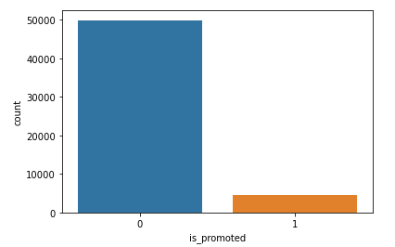
Visualization
Is_promoted variable representation using countplot
Not_promoted employee is more in the dataset

Slide 8
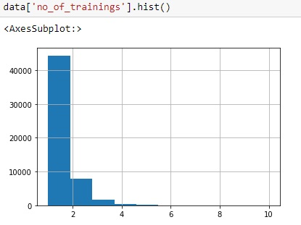
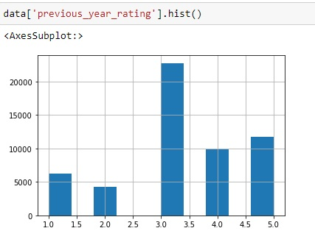
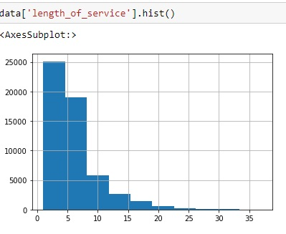
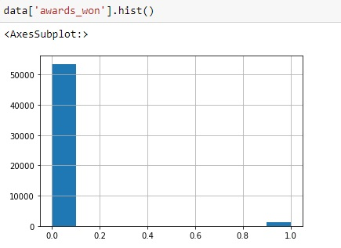
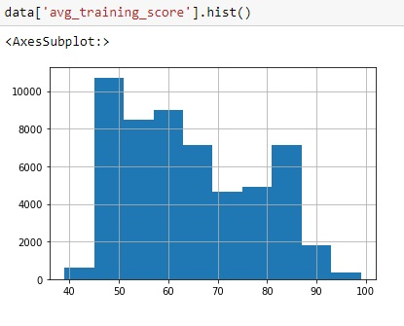
Drawn histogram for Numerical feature distribution of No_of_trainings, previous_year_ratings, length_of_service, awards_won & avg_training_score

Slide 9
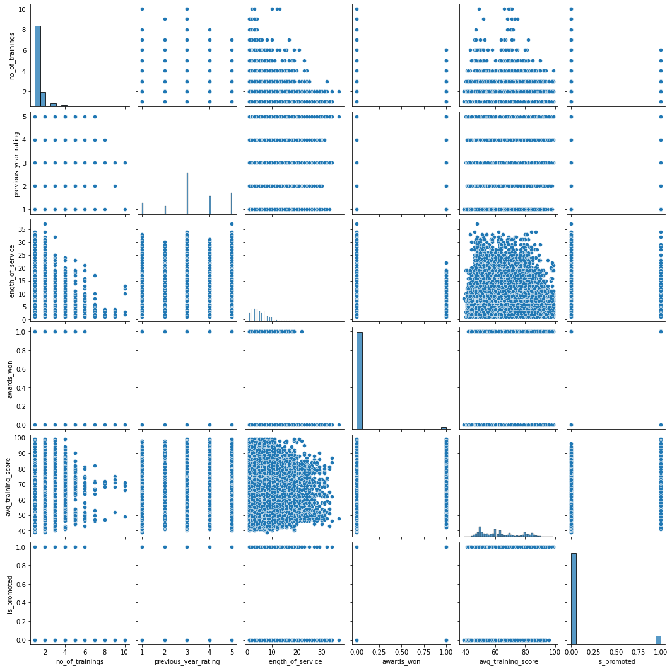
Scatter plot for all the variables

Slide 10
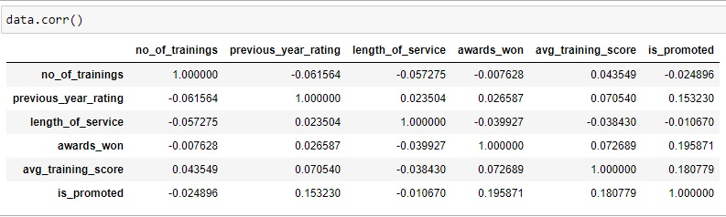
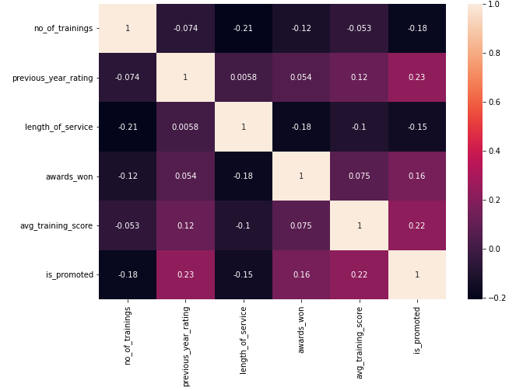
Correlation
Correlation is the statistical relationship between two variables
age and length_of_service has good correlation with class variables
HEATMAP

Slide 11
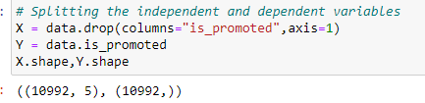

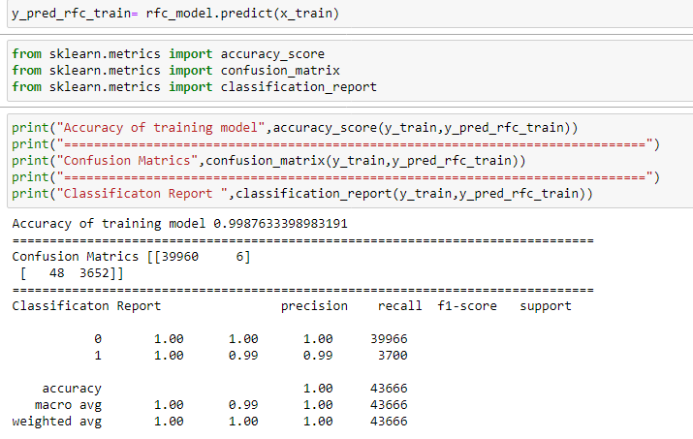
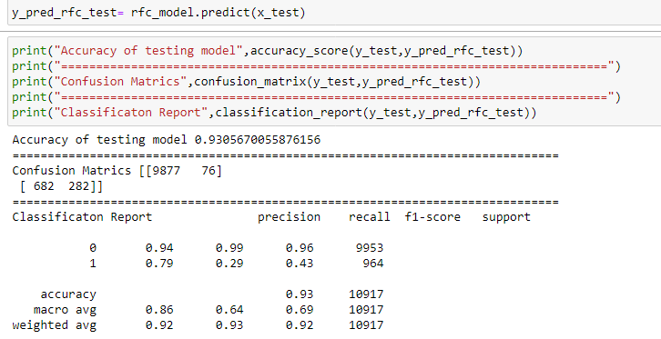
Model validation

Slide 12
Model building
10 models are built
Logistic Regression: Used to predict a binary outcome: either something happens, or does not.
Support vector machine: Uses algorithms to train and classify data within degrees of polarity, taking it to a degree beyond X/Y prediction.
Naive Bayes: Calculates the possibility of whether a data point belongs within a certain category or does not.
K- Nearest neighbor: To locate all of the closest neighbours around a new unknown data point in order to figure out what class it belongs to
Decision Tree: It produces a sequence of rules that can be used to classify the data.
Random Forest: Fits a number of decision trees on various sub-samples of datasets and uses average to improve the predictive accuracy of the model and controls over-fitting
Neural network: They can recognize hidden patterns and correlations in raw data, cluster and classify it, and – over time – continuously learn and improve.
XgBoost: One of ensemble boosting classifier. It combines multiple classifiers to increase the accuracy of classifiers.
Bagged Decision Tree: It combines multiple learners in a way to reduce the variance of estimates.
Gradient Boost

Slide 13
Accuracy of different model
Sl.No | Model | Training Accuracy | Testing Accuracy
1 | Random Forest | 89.21 | 89.71
2 | Logistic Regression | 90.68 | 90.89
3 | Naïve Bayes Classifier | 89.59 | 89.80
4 | SVM | 91.45 | 91.58
5 | XGB | 90.07 | 90.30
6 | Decision Tree | 89.58 | 89.74
7 | KNN | 88.09 | 88.48
8 | Gradient Boosting Classifier | 92.48 | 92.61

Slide 14
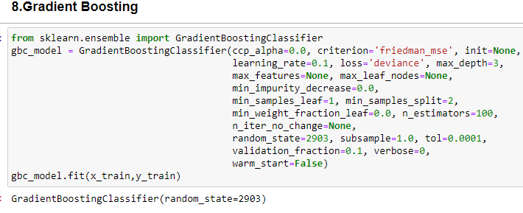
Final model
The best model for this dataset is Gradient Boosting model. It gives training accuracy of 92.48% and testing accuracy of 92.61%.

Slide 15
Deployment
We used Gradient Boosting Classifier model to deploy the employee dataset. Because it shows highest accuracy
For deployment we are using streamlit because of its simplicity, easy to use.
Streamlit is an open source app framework in Python language. It helps us create web apps for data science and machine learning in a short time
1 indicates promoted and 0 indicates not promoted

Slide 16
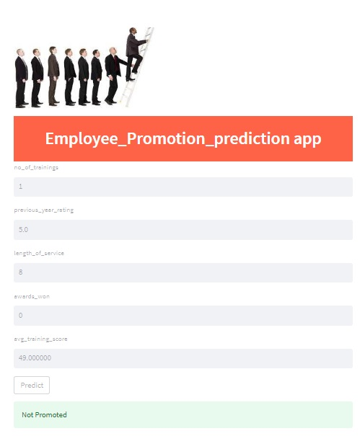

Slide 17
Challenges Faced
The date set had a lot of duplicate values ​​which was a challenge whether to remove it or not.
Choosing the best accuracy model was a challenging situation accuracy
The dataset has many missing values which was a challenge whether to remove ot not
It is a large dataset and having many categorical variables so challenges are more
How did we overcome the challenges?
It is a large dataset , replace missing values with mean , mode and median
Comparing testing and training accuracy of all model to finalize the best model
Visualization of data is more usefull for us, to know how to handle the data

Slide 18


